Slide 1
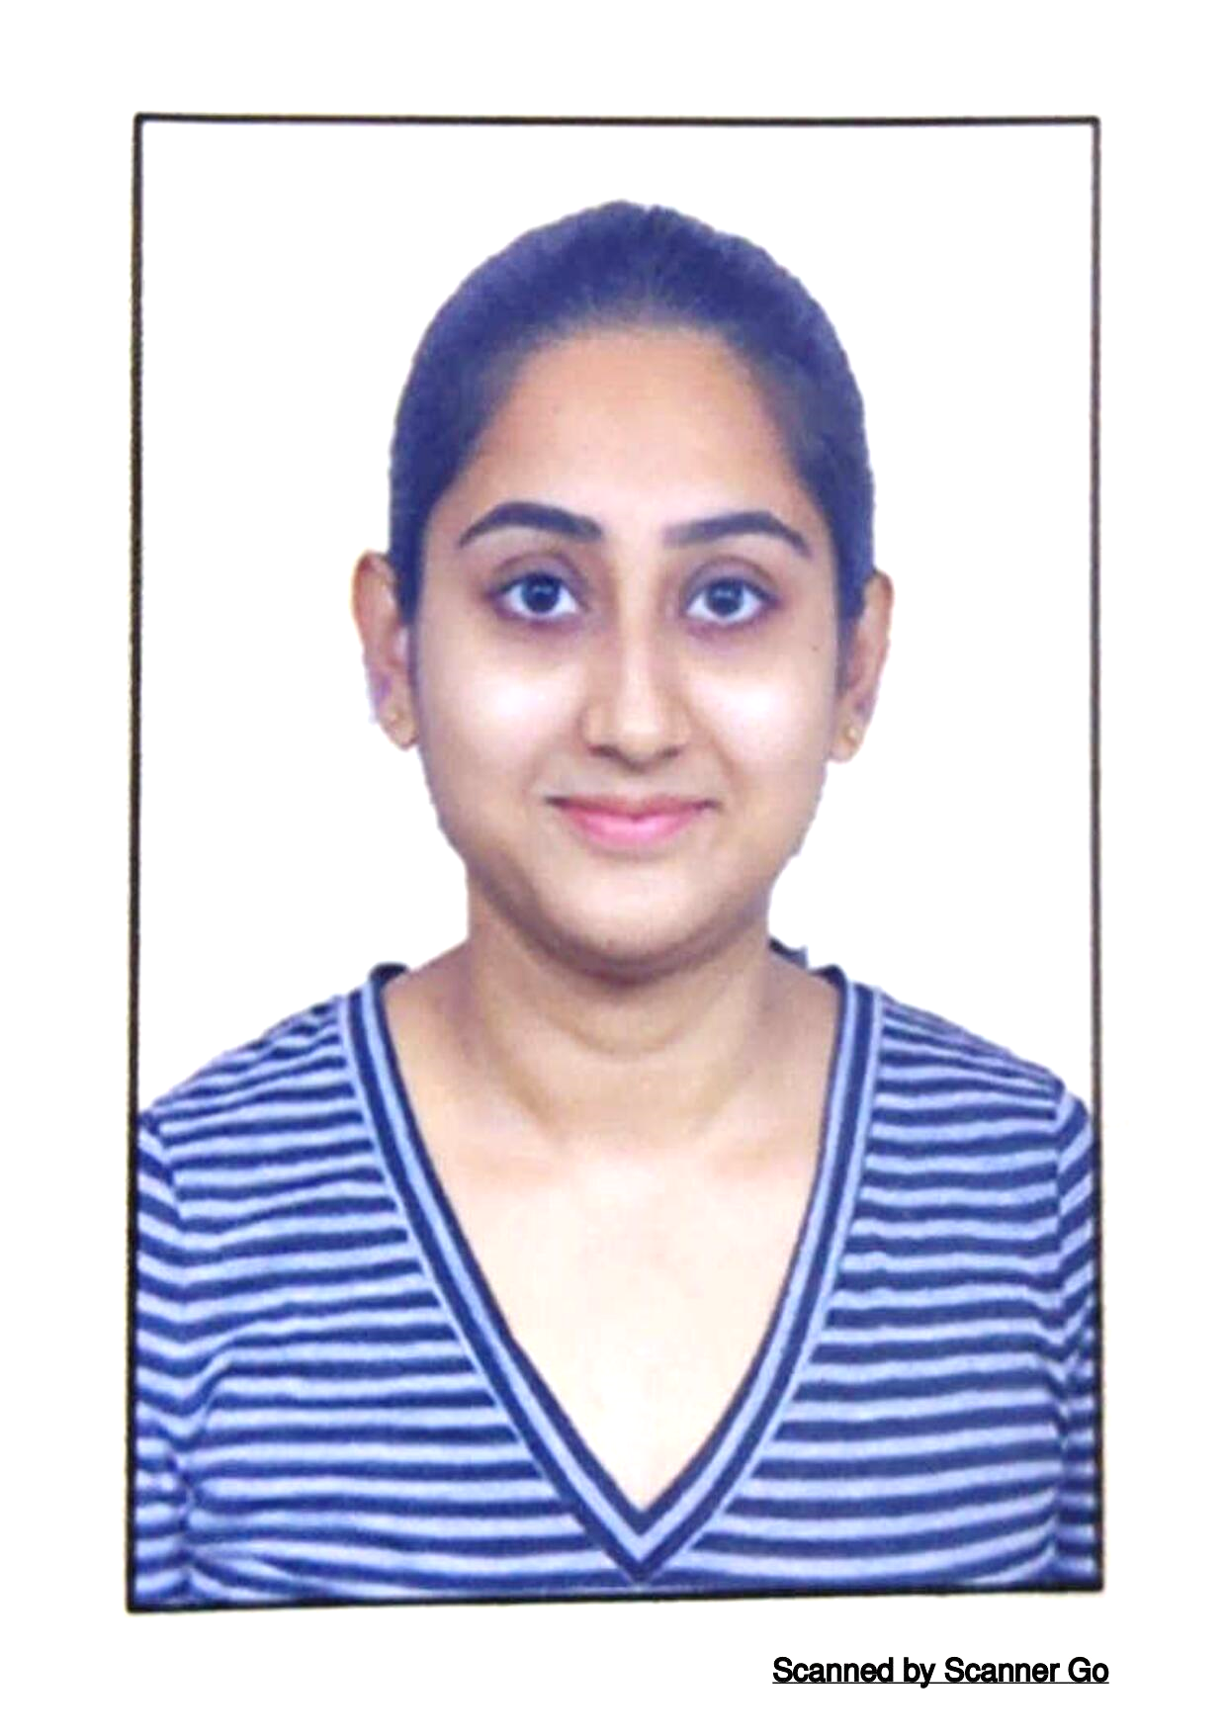



Sai Sreeja Bhanothu
Analyst/Software Engineer
Bachelor of Technology
Computer Science : 2016 - 2020
Skills Java 8 /J2EE
Spring Boot
Spring MVC
JPA CRUD
Bootstrap
Angular
Database
SQL database – MySQL
No SQL database – MongoDB
Web Technologies
HTML5
CSS3
JavaScript
Add-ons
GitHub
Maven
Postman
Additional Details
Leadership
Excellent Communication Skills
Team management
Quick Learner
Bangalore
Bhanothu.sai-sreeja@capgemini.com
+91 9100077669
A4
Software Engineer who is Strong in design and integration with intuitive problem-solving skills. Passionate about implementing and launching new projects.
Ready to learn new technologies and implement them to further improve my knowledge.
Eager to work in a team of dedicated people and serve a key role in the enhancement and development of the project.
Has working knowledge on Java Microservices Development using Spring Boot and Angular on an intermediate level.
Flight Booking System
Completed end to end case study of Flight Booking System Application along with JWT authentication, Swagger and payment testing using Braintree in MERN Stack. Material-UI and React Bootstrap used for user interface.
HTML, CSS, JAVASCRIPT for web developers at Coursera
Completed this course with 98.6% and Designed responsive Restaurant website using HTML5 CSS3 Bootstrap and JavaScript.
Angular, Spring Boot and MongoDB
Learned and completed all the concepts of Frontend, Middleware and Backend at Capgemini Degreed Platform.
Check out my work on GitHub and video profile

